Slide 1

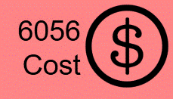
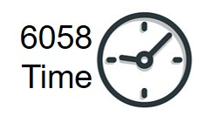




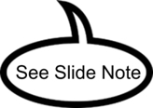
MGMT 6058 Module 3
Some slides are exclusive to either 6056 or 6058
Exercises
Do the exercise prior to next slide
Videos
Solution Slide
PPT Animations
Exercise Simulation
Networks, Duration Estimation
M3 Wedding WBS (1).mpp
See text in “slide note” for more details
M3 Duration Distribution of 29 Projects and Sigma.xlsx

Slide 2
Module Learning Objectives
Understand how to create a Schedule Management Plan
Understand and apply key scheduling terminology.
Apply the logic used to create activity networks, including predecessor and successor tasks.
Develop an activity network using Activity-on-Node (AON or AOA) techniques.
Perform activity duration estimation based on the use of probabilistic estimating techniques.

Slide 3

What steps would you take to figure out how long
it would take to complete a complex project?

Slide 4
MGMT 6058 Module 3
Part 1
Plan Schedule Management

Slide 5
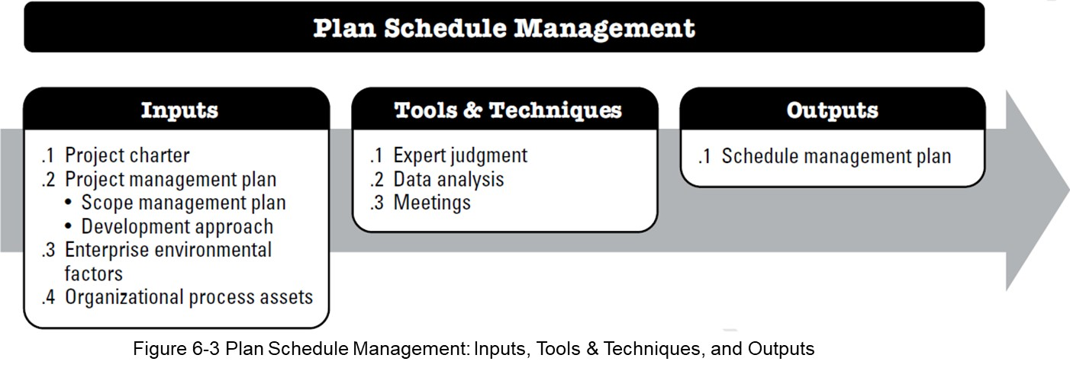
Plan Schedule Management
Schedule management plan, the overall plan or guidance for the Schedule Management Knowledge Area
Source: PMBOK 6th Edition, 2017

Slide 6
The Schedule Management Plan can include:
Project schedule model development: What methodology and tool will be used to develop the schedule.
Level of accuracy: The acceptable range used in determining the realistic activity duration estimates.
Units of measure: Time measures (such as staff hours or staff days) and quantity measures such as (imperial or metric) are defined for each of the resources.
Organizational procedure links: The WBS provides the framework for the schedule management plan.
Schedule maintenance: How the schedule will be updated and statused.
Control thresholds: What variance is allowed before some action needs to be taken
Rules of Performance measurement: How percent complete is reported, control accounts at which management of progress will be measured, Earned value measurement techniques to be employed, schedule performance measurement to be used
Reporting formats: the formats and frequency for the various schedule report are defined.
Process descriptions: descriptions of the schedule management processes are documented

Slide 7

A Schedule Management Plan for Deck Alpha:
Project schedule model :
Level of accuracy:
Units of Measure:
Organizational links:
Project schedule model maintenance:
Control thresholds:
Rules of performance measurement:
Reporting Formats:
Process description:
No level of precision listed for Schedule Management as there is in Cost Management, why?
Notes:
Durations are typically measured in work days or hours. We typically don’t use precise time measures such as “it will be done in 6.74 hours”. That fact that they might be 0.1 hours late (6 minutes) is typically irrelevant.

Slide 8
Schedule Management Plan for Deck:
Project schedule model development: Waterfall methodology will be used. MS Project will used to develop the schedule. A Network Diagram and Gantt chart will be developed using the Critical Path Method, PERT method for duration estimation, Activity on Node (AON) Networks and incorporating Lags where possible.
Units of Measure: Durations will be recorded in days, work in hours.
Level of accuracy: All initial estimates will be expressed to the nearest single decimal (e.g. 5.6 days of duration or 4.3 hours or work).

Slide 9
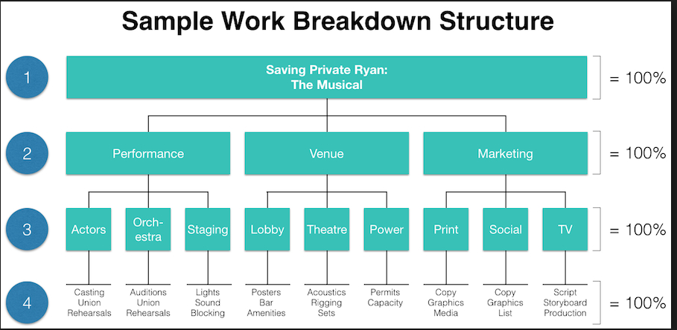
Cost Management Plan for a Deck
Organizational procedure links: Both 2nd and 3rd level WBS Elements (based on the cost of the element for example) will be assigned control accounts linking directly to the accounting system.
We may want to have control accounts at level 2 (Major Deliverable) for Venue, but at the WP level for Performance

Slide 10
Schedule Management Plan for Deck (cont’d):
Project schedule model maintenance: The project supervisor will collect the status weekly and update the MS Project file with the status. Actual, new start and finish dates and percent complete will be recorded.
Control thresholds: If schedule variance is greater than +/-10% and +/- 1 hour of the budgeted time then action needs to be taken.
Rules of performance measurement: Percent complete will be statused as 0%, 25%, 50% , 75% or 100%, progress will be measured at the second level, EVMS will be used, schedule variances and schedule performance indexes will be calculated.
Reporting Formats: The project supervisor will provide weekly reports. For each second level deliverable the following will be reported: baseline start and finish dates, new estimated start and finish dates, % complete, labour hours used, new estimated labour hours to complete and SPI and SV. For the entire project a new estimated completion date will be provided. Tracking Gantt chart will be provided.
Process description: All reporting and collecting of labour hours will be done with Control Accounts at the second indenture of the project WBS

Slide 11
Part 2
Scheduling and Duration Estimation

Slide 12
Project Scheduling
Which is the bigger picture?
Project scheduling requires us to follow some carefully laid-out steps, in a specific order, for the schedule to take shape.
Project planning, as it relates to the scheduling process, has been defined by the PMBOK as:
The identification of the project objectives and the ordered (sequentially ordered) activities necessary to complete the project including the identification of resource types and quantities required to carry out each activity or task.
Source: PMBOK 6th Edition, 2017

Slide 13
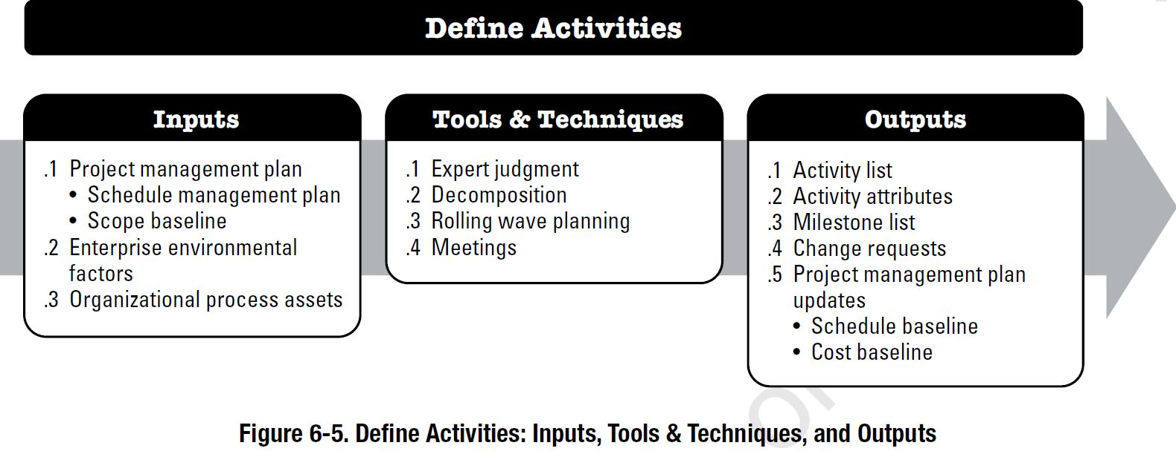
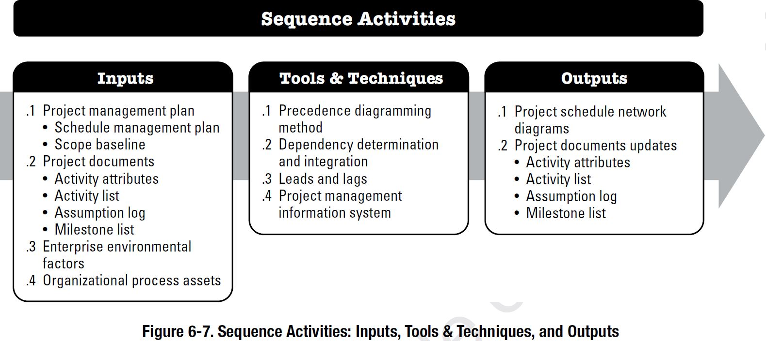
Project Scheduling – Define Activities & Sequence Activities (2nd & 3rd processes)
Creation of an Activity List based on Work Packages from the WBS
Sequence Activities in our Activity List, based on identification of predecessors/ successors.
Source: PMBOK 6th Edition, 2017

Slide 14
Project Scheduling Terms
Network diagram – a diagram that shows activities with scheduling relationships
Node – is this diagram, Activity B is a node (circle)
Successors – D is a successor to both B and C
Predecessors – D is a predecessor to E
Critical Path – the longest path.
B
A
D
E
F
C

Slide 15
AOA Versus AON
Which is more widely used?
One example of why you would use AOA?
Which one is MS Project?
An example mini-project is shown with activities on arcs or arrows … AOA
D
E
B
F
C
…and activities on node AON
These 2 diagrams are the same mini-project
D
E
B
F
C
Notes:
Typically AON is more widely used, such as it’s use in MS Project. One example of why you might use an AOA would be when you have critical meetings (events) throughout your project that you cannot reschedule easily.

Slide 16

Serial Activities
Could also be called Sequential
Serial (sequential)activities are those that flow from one to the next, in sequence.
Figure 9.5

Slide 17
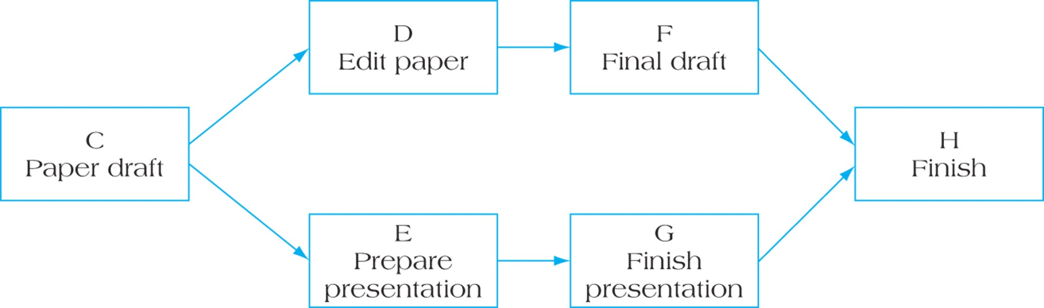
Activities Linked in Parallel (Concurrent)
When the nature of the work allows for more than one activity
to be accomplished at the same time, these activities are considered to be concurrent and parallel project paths, which can be constructed throughout the network diagram.
Real examples?
Figure 9.6

Slide 18
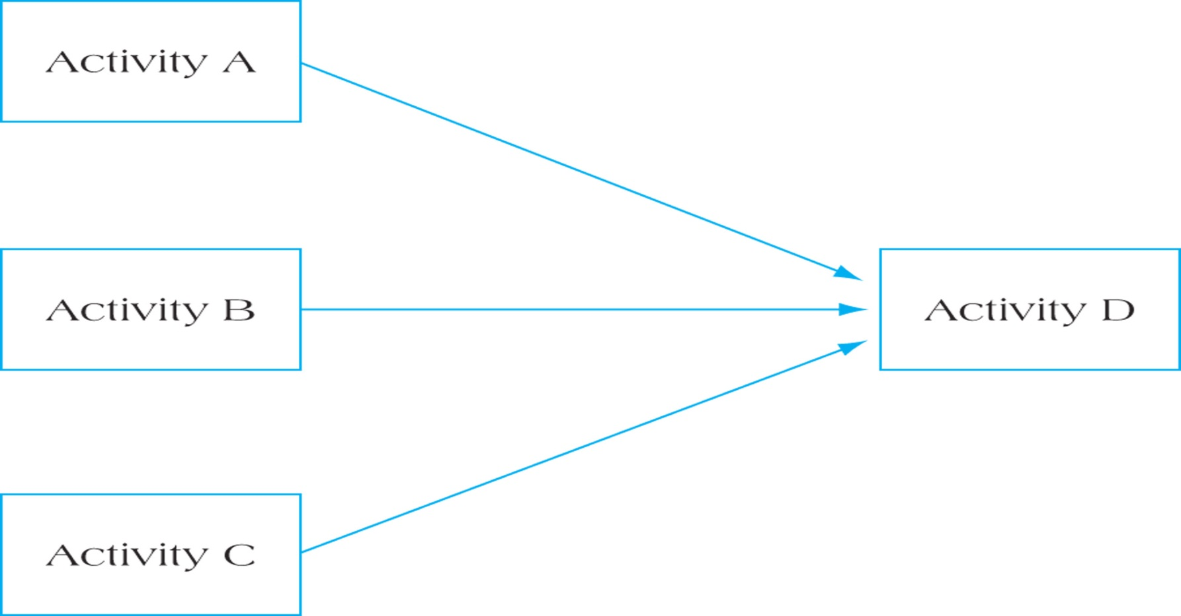
Merge Activity
Real examples?
Figure 9.7

Slide 19
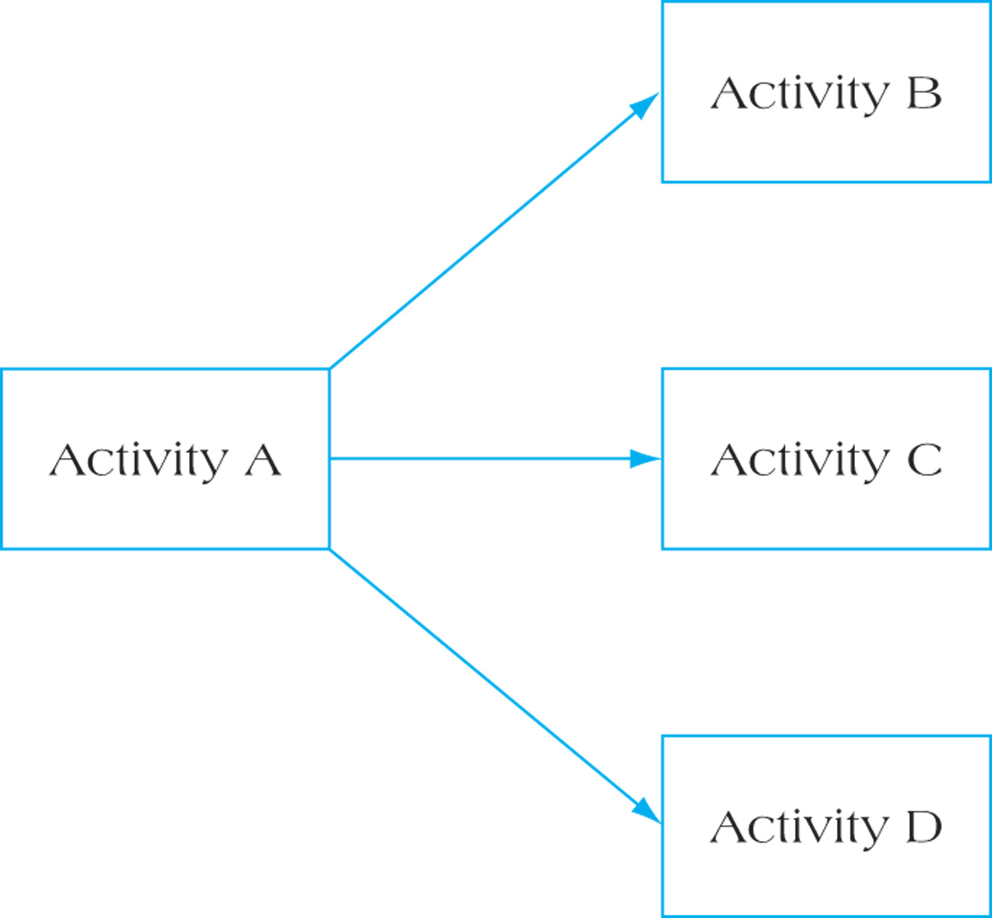
Burst Activity
Real examples?
Figure 9.8

Slide 20
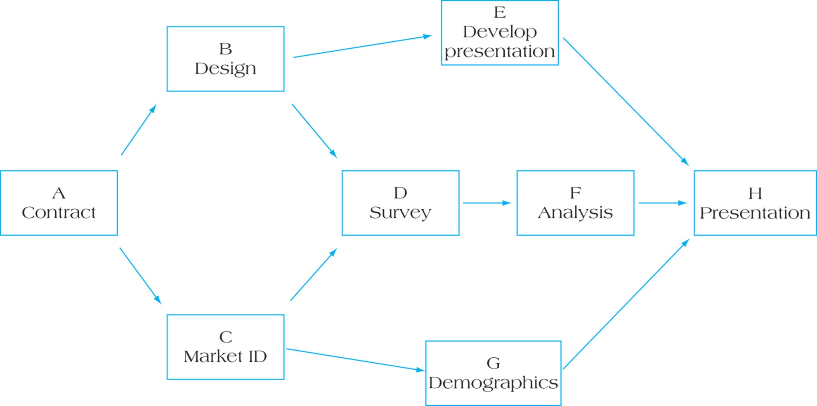
A Complete Activity Network
Figure 9.10

Slide 21
Rules for Network Development
Some determination of activity precedence ordering must be done prior to creating the network.
Network diagrams usually flow left to right.
An activity cannot begin until all preceding connected activities have been completed.
Arrows on networks indicate precedence and logical flow.
Each activity should have a unique identifier associated with it (number, letter , WBS code etc.).
Looping, or recycling through activities, is not permitted.
It is common to start a project from a single beginning node and end on a single node.

Slide 22
Example of Activity Precedence Ordering in a table format.
Activity | Description | Predecessors
1.1 | Decide on date | None
1.2 | Marriage License | 1.1
1.3.1 | Rent church | 1.1
1.3.2 | Florist | 1.1
1.3.3 | Create/Print Programs | 1.1
1.3.4 | Hire Photographer | 1.1
1.3.5 | Wedding Ceremony | 1.2, 1.3.1. 1.3.2. 1.3.3. 1.3.4
1.4.1 | Develop Guest List | 1.1
1.4.2 | Order Invitations | 1.4.1, 1.3.1, 1.5.1
1.4.3 | Address and mail invitations | 1.4.2
1.4.4 | Track R.S.V.Ps | 1.4.3
1.5.1 | Reserve Reception Hall | 1.1
1.5.2.1 | Choose Caterer | 1.5.1
1.5.2.2 | Decide on Menu | 1.5.2.1
1.5.2.3 | Make final order | 1.4.4, 1.5.2.1
1.5.3 | Hire Band | 1.5.1
1.5.4 | Decorate reception hall | 1.5.1
1.5..5 | Wedding Reception | 1.3.5, 1.5.2.3, 1.5.3, 1.5.4
This would probably be in an Excel file.

Slide 23
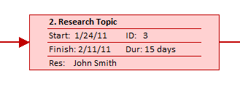
Node Labels for AON Networks
Early Start
ID Number
Early Finish
The name of a Resource(s) assigned to this Activity or Node could be added but usually isn’t.
Activity Float
Activity Descriptor
Late Start
Activity Duration
Late Finish
Activity Node Labels Using MS Project
Note this is not as easy to read as above and although it has a Resource Name, it is missing information per above
Figure 9.4

Slide 24
Construct an AON network activity diagram 2 ways based on the following information:
Activity | Preceding Activities
A | -
B | -
C | A
D | B,C
E | B
F | C, D
G | E
H | F
I | G,H
Create Network Diagram 1) sketch by hand on paper and then 2) in MS Project.
But by hand first …

Slide 25
Network Diagram by hand
F
A
C
H
D
I
B
E
G
You can start with the first activity and work forward or start with the last activity
and work your way backwards.
Let’s build one in MS Project, use 1-day durations

Slide 26
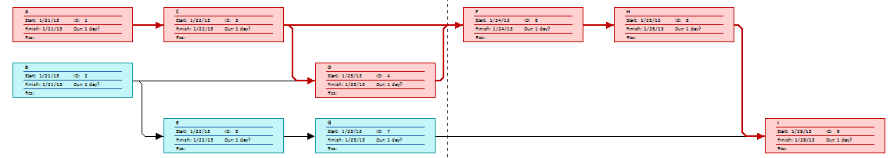
Network Diagram View in MS Project
How many paths?
What is the difference between the red and blue boxes?
Can you identify where the burst and merges are?
Notes:
One way of navigating to the Network Diagram View in MS Project is via the View tab, then Network Diagram.
There are 4 paths. By default we are using 1-day durations. The longest path would be 6 days, and is highlighted in red. The longest path dictates how long the project will take and is called the critical path. The first blue Activity is a burst and the last Activity is a merge.

Slide 27
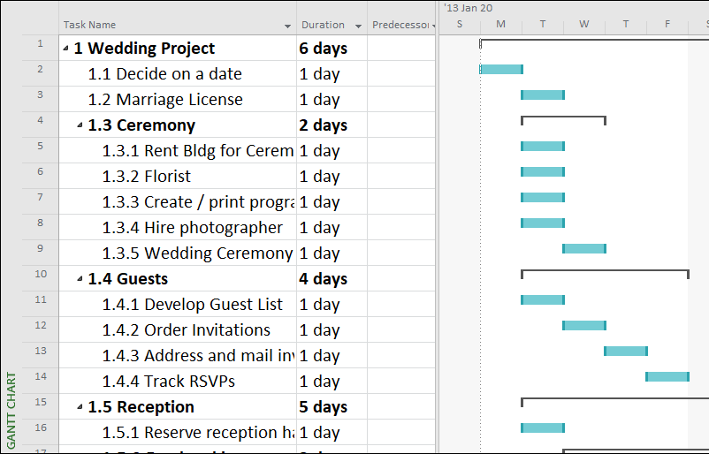
Creating a Project Network for a Wedding
In groups of 2 or 3 (or as an individual) create a project network diagram from an existing WBS for a wedding in a MS Project file
See FOL, for the M3 Wedding WBS (1) MPP File
Decide as a group (or individually) what the Predecessors Activities are for each activity and input them into the MS Project file. Enter the row number into the predecessor column.
If you decided that you didn’t want to “Rent Bldg for Ceremony” until after you secured a Marriage License, then the predecessor to Rent Building would be row 3, so you would enter a “3” in the predecessor column.
3
Note the activities are show as “bars”, we only use predecessor relationships between activities
M3 Wedding WBS (1).mpp

Slide 28
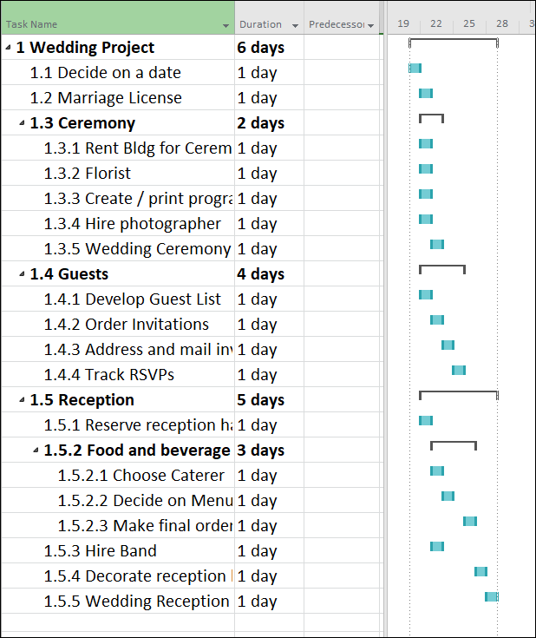
Wedding WBS, Activities vs Deliverables
The upside down “U”s are deliverables and are called Summary Tasks in MS Project
“1 Wedding Project” and 1.3 Ceremony are both summary tasks
But note, MS Project does NOT visibly differentiate WP’s from higher level deliverables
The blue bars are activities and are called Detailed Tasks in MS Project
1.4.3 Marriage license is a detailed task
But where are the WP’s in this table?
Notes:
Assuming the WBS is constructed correctly, the WP’s would be the immediate level above the activities, or in other words, only WP’s can have activities underneath them. But this WBS has flaws.

Slide 29
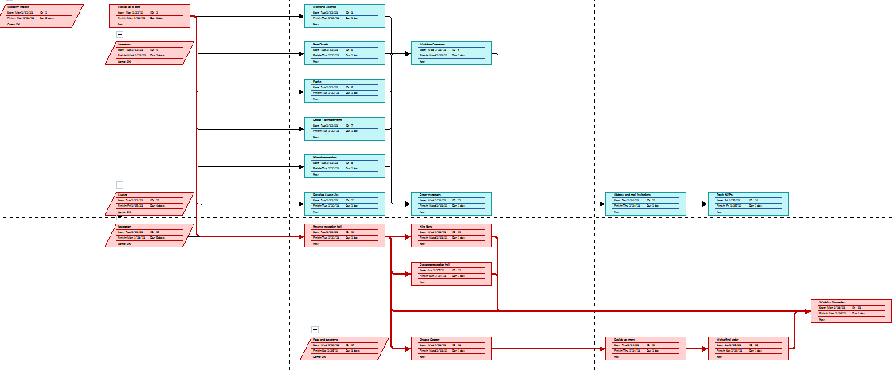
Let’s look at the Network Diagram View in MS Project
What do the rectangles mean?
What do the parallelograms mean?
What do the red rectangles mean?
Notes:
One way of navigating to the Network Diagram View in MS Project is via the View tab, then Network Diagram.
Rectangles are Detailed Tasks in MS Project, or Activities.
Parallelograms are Summary Tasks in MS Project, which could be WP’s, higher level deliverables or even the project level deliverable.
Red rectangles are Activities on the critical path (the longest path) which dictate the length of the project.
Error? An arrow should NOT connect to or from a deliverable (which is called a summary task in MS Project and shown as a parallelogram). It’s very subtle but there is an arrow line starting from the parallelogram midway along the left side of the diagram.

Slide 30
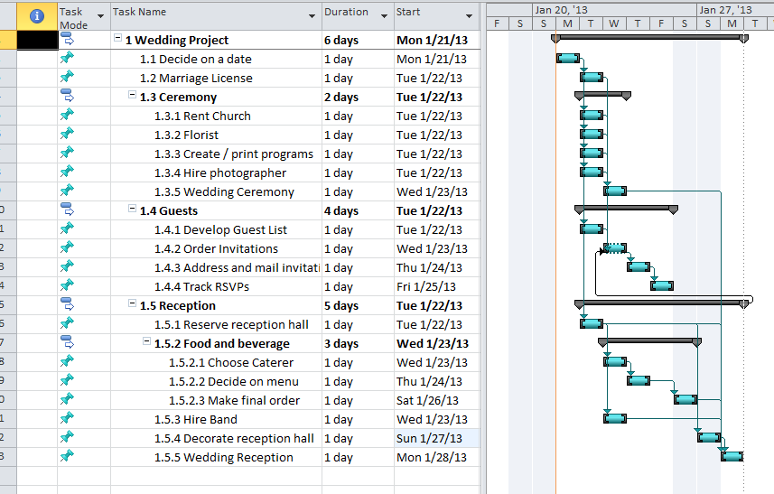
Here is an example of relationships (Predecessors) in MS Project with Errors

Slide 31

Let’s identify the errors!
Using this Gantt View in MS Project, can you spot 4 errors?
Notes:
Note Activities are in manual mode.
#1 – are 1.1 and 1.2 under a WP?
#2 - What is the predecessor to 1.4.2?
#3 - What is the successor to 1.4.4?
#4 – We have 3 activities underneath 1.5.2, but what WP’s do 1.5.3 to 1.5.5 fall under?
Fix
#1 – 1.0 is not a WP, we need to introduce a WP below 1.0
#2 - What is the predecessor to 1.4.2? 1.5 is not an Activity and should not be a predecessor, perhaps only 1.4.1 and 1.2 are predecessors.
#3 - What is the successor to 1.4.4? => add a successor, there is an obvious one. Without a successor we are saying we can perform the wedding without actually completing 1.4.4.
#4 - 1.5.3 to 1.5.5 fall under 1.5 but 1.5 isn’t a WP, it’s a higher level sub-deliverable, so we need to add 1 or WP’s under 1.5 to deal with not only 1.5.3 to 1.5.5 but also 1.5.1.

Slide 32
Examples of Start to End Activities in a Project as seen in an MS Project Gantt Chart
The comments in these next few slides are for learning purposes only.

Slide 33
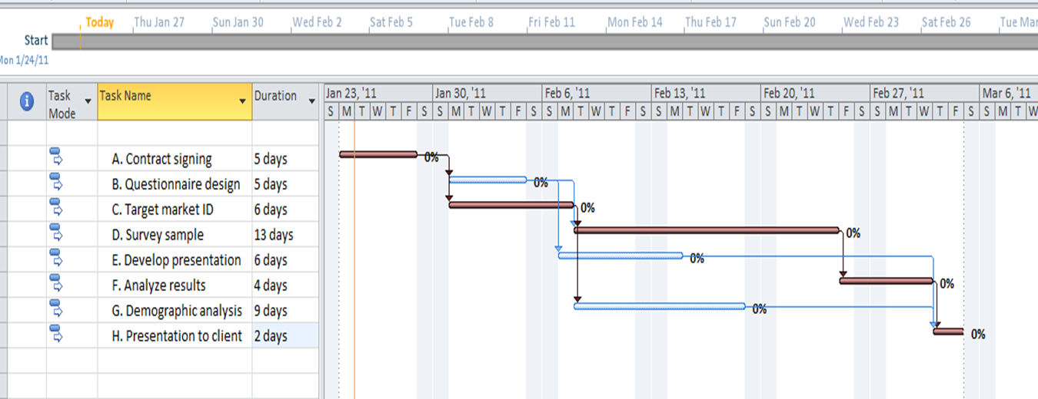
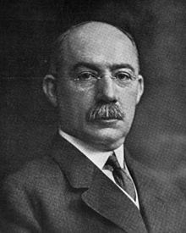
The Gantt Chart
Retrieved from Wikipedia https://en.wikipedia.org/wiki/Gantt_chart#cite_note-FOOTNOTEKlein199949-3
Henry Gantt invented the graphic schedule based chart, circa 1910 to 1915, now called the Gantt Chart
A Gantt Chart. A graphical, calendar schedule showing the durations of activities.
In this MS Project example the sequence of the work to be done is conveyed by the arrows between the activities.

Slide 34
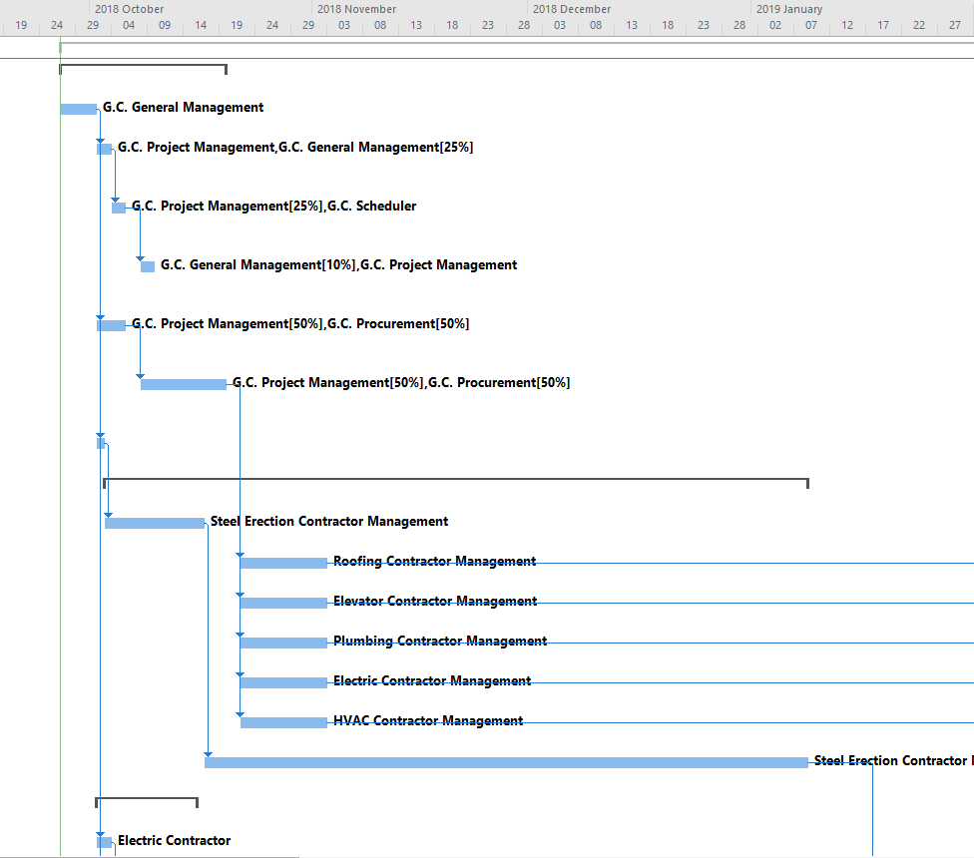
Example Project Gantt Chart with Single Start Activity
A single start Activity at the start of the project, this could be a kick-off meeting
An “orphaned” or “abandoned” Activity (no successor) we are avoiding these
Notes:
An “orphan” means there is no successor task, including the last finish task in the project, that depends on the orphan task. So why would we have to finish the orphan to finish the project? Almost all tasks need a successor.

Slide 35
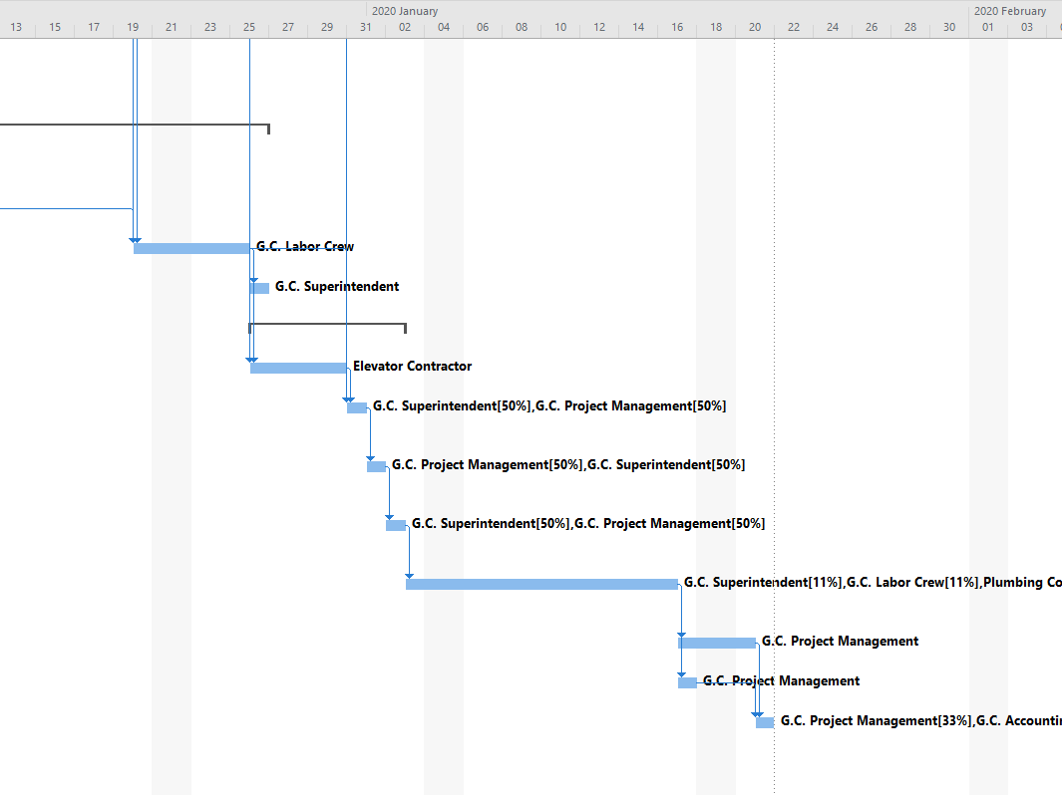
Example Project Gantt Chart with Single Start Activity
Multiple paths can be seen in the project, this is typical in most projects
A single finish Activity - it could be an “end of project” activity like an inspection
Notes:
If you have more than one finish task in a large project you may miss it. The same goes for a start task. That’s why it’s a good idea to have just one start and one finish task in a project.

Slide 36
This section is similar in 6056 & 6058
Part 3
3-point estimates, PERT, and Statistical Cost Estimation including probabilities

Slide 37
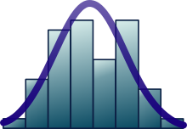
Standard Deviation Calculator
Use this webpage to create the Standard Deviation for a set of data. Enter 10 positive numbers in the light green box that represent time (in minutes) for the last 10 times it took you (you can guess) to travel to your college (or work). Use the “Sample” radio button. https://www.mathsisfun.com/data/standard-deviation-calculator.html
Follow the calculations, the turquoise area is the mean or average.
Examine the chart noting your data points, the mean, and -1SD and +1SD (SD is Standard Deviation)
SD’s can be used to create “ranges” e.g. a mean of 40 min +/- an SD of 6 min is a range from 34 to 46 min.
Ignore the formulas at the bottom of the page.

Slide 38
Normal Distribution
Work your way through this webpage but STOP before “Why Standarize …?” https://www.mathsisfun.com/data/standard-normal-distribution.html
Try the business problem: We want to tell a customer a range for the time it will take to perform a project, the “project duration”. We want to be 95% certain of our answer. We have done this type of project many times before so we know on average it takes 45 days and the SD (Standard Deviation) is 5.5 days. What is the range we would tell the customer?
Notes:
From the website we know if we use 2 SD’s on either side of the mean, we know 95% of the time the project duration will be between +/- 2 SD’s.
So we take our mean and subtract 2 SD’s , and add 2SD’s.
- 2 SD’s 45 – 2 x 5.5 = 45 -11 = 34
+ 2 SD’s 45 + 2 x 5.5 = 45 +11 = 56
So the range is 34 to 55 days, and we are 95% certain the project duration will be in this range.

Slide 39
Duration and Cost Estimation Probability
For 6056 Cost, we are estimating costs ($’s) but for 6058 Time, we are estimating durations!
Estimates are based on normal working methods during normal business hours. But realistically estimates should be a range of numbers representing probabilities and based on:
Research
Past experience
Expert opinion
Mathematical derivation, for example:
Most likely (m)
Most pessimistic (b) sometimes called “p”
Most optimistic (a) sometimes called “o”

Slide 40
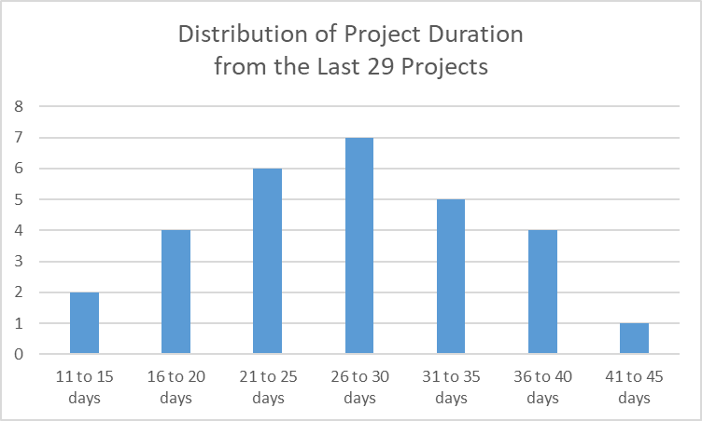
Duration and Cost Estimation Probability
In this chart, we have graphed the duration of the last 29 projects we did. They were quite similar, but note we have a wide range of durations. While we would most likely get a new project done in 26 to 30 days, it could take between 41 to 45 days.
Although this diagram indicates duration (time) a similar story could be graphed for the cost of projects.

Slide 41
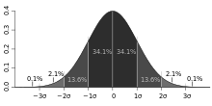
Statistics and Estimation Normal Probability Distribution
What is a standard deviation? Also called “sd”, sigma, or σ. It provides an indication of the width or range of the distribution.
Once we know sigma, it’s common to reference 1, 2, and 3 sigma’s which is called the 68–95–99.7 rule. For example, in the previous slide if the average project duration was about 27 days and sigma was 8 days, 34.1% of the durations would be between 27 days and 35 days, or about 68% would be between 19 and 35 days
Source: https://en.wikipedia.org/wiki/Standard_deviation
~ 68%
Sigma = 8 days
19 days 27days 35 days
M3 Duration Distribution of 29 Projects and Sigma.xlsx

Slide 42
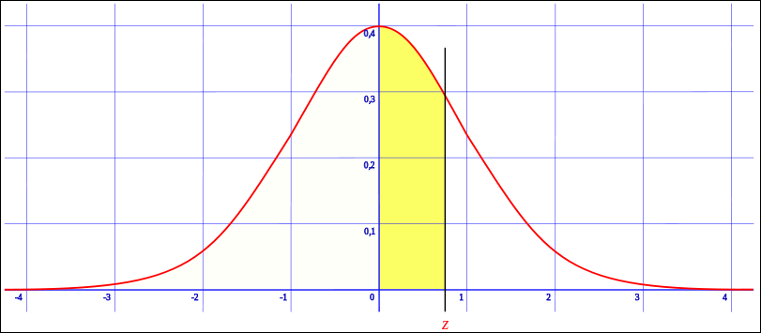
Statistics – Normal Probability Distribution is based on Standard Deviations (SD)
We can use tables, online calculators or Excel to determine probabilities for specific sigma’s
Z on the horizontal axis represents the number of standard deviations
https://en.wikipedia.org/wiki/File:Z_cumulative_from_mean.svg
https://www.mathsisfun.com/data/standard-normal-distribution-table.html
This link is a great interactive tool to experiment with standard deviation, Z, and probabilities. Change the radio buttons for Z, and compare your results on the interactive graphic, with the tables below it (scroll down). For example, use +1.0 Z in the interactive graphic and match your probability with the tables below the graphic.

Slide 43
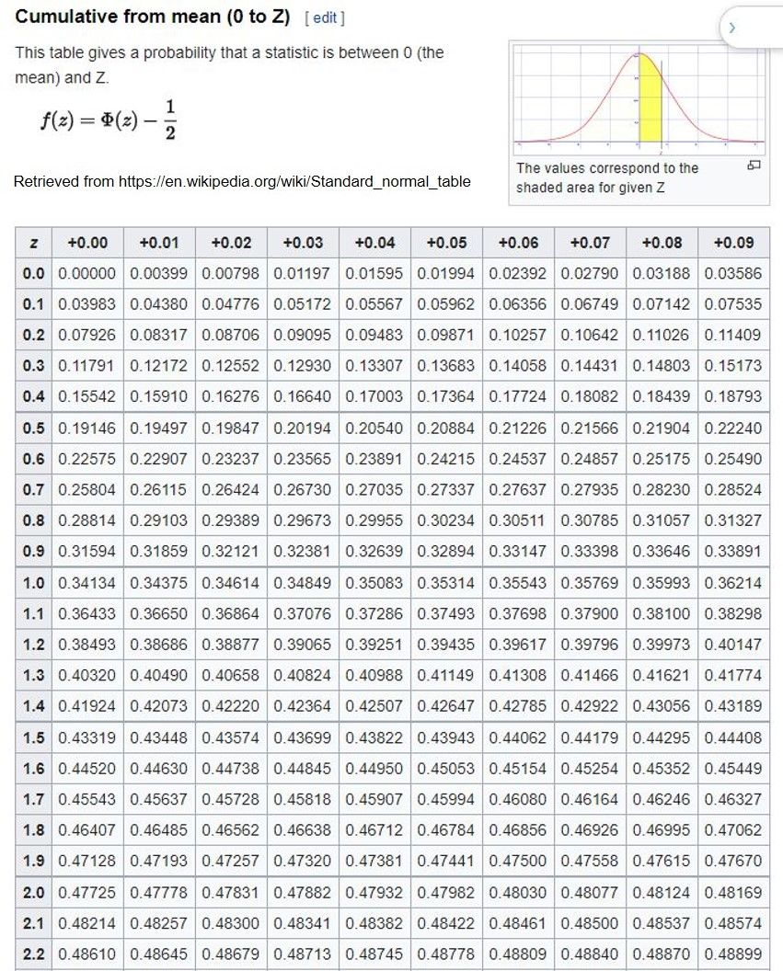
Probability Distribution
We can use this Z table to determine the probability of a scenario date for a project, but we need to know:
Estimated project duration
Project standard deviation from the project variance
What is the scenario date
Z, via a calculation
And then we can use the Z table to determine the probability
Note the key for the Z Table

Slide 44
Exercise Project Gamma-Schedule Probability Distribution
Q1: If we had an estimated duration of 50 days, a sigma of 20 days, and we wanted to know the probability of the project being finished less than 65 days to avoid a penalty, what would the probability be?
Q2: What if we wanted to know the probability of the project being finished within 40 days to earn a bonus, what would the probability be?
Note the key for the Z Table

Slide 45
Answers
Q1 – Avoiding a Penalty
Z represents the number of standard deviations we are interested in, which would be (65-50)/20 or 15/20 or 0.75 standard deviations. Using the table, 0.75 equals 0.27337 or 27.3% probability.
But, per the yellow area of the key at the top right, 27.34% represents the probability between 50 and 65 days. We want to know less than 65 days.
All of the area under the curve is 100% of the probability, so the left side of the picture is 50%. We add the left side with the yellow area to get 50% + 27.34% = 77.34%.
You can double check your Z table lookup 2 ways, use the link https://www.mathsisfun.com/data/standard-normal-distribution-table.html and use the radio button setting at the top left “Up to Z”, or … you can use the Excel formula =NORM.DIST(65,50,20,TRUE)
Q2 – Earning a Bonus
This is a bit trickier given the limitations of our table.
Z represents the number of standard deviations we are interested in, which would be (40-50)/20 or -10/20 or -0.5 standard deviations. Using the table, 0.5 equals 0.19146 or 19.15% probability.
We are saying there is a 19.15% probability of the project duration being between 40 and 50 days.
Using the left side of the table is 50% probability, we can say there is 50% probability of the project being less than 50 days.
And if there is a 19.15% probability of the project duration being between 40 and 50 days we can say there is 50% - 19.15%, or a 30.85% of the project finishing under 40 days.
You can double check your Z table lookup 2 ways, use the link https://www.mathsisfun.com/data/standard-normal-distribution-table.html and use the radio button setting at the top left “Up to Z”, or … you can use the Excel formula =NORM.DIST(40,50,20,TRUE)

Slide 46
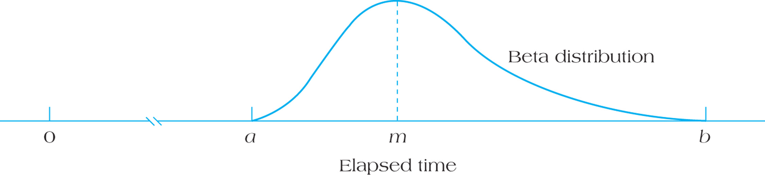
Asymmetrical (skewed or Beta) Distribution
See this link for a YouTube example of a normal distribution and a skewed distribution 3:23 minutes
https://www.youtube.com/watch?v=XSSRrVMOqlQ
Skewed estimates are typically more realistic for duration and cost estimates, but it’s simpler to use a normal distribution
Why is an asymmetrical estimate more realistic than a symmetrical one for costs or durations?
Most
Likely
Optimistic
Pessimistic
FIGURE 9.15 Asymmetrical (Beta) Distribution for Activity Duration Estimation
Notes:
When things go wrong they can go really wrong. For example something that might take 6 days normally (ML or most likely), might take 12 days when everything goes wrong (rare but it happens). The difference between the P and ML is 12 – 6 = 6 days. If the curve was symmetrical, that means the Optimistic O would also be 6 days from ML. So O would be ML – 6 or 6 – 6 = 0 days. Realistically, if everything went absolutely perfect we might expect O to be 2 or 3 days, but not zero days.

Slide 47
Activity Durations and Variances
Where are there symmetrical estimates?
Are O and P symmetrical around “Likely” very realistic?
Table 9.2
Notes:
Although we use symmetrical normal distribution curves, sometimes called Bell Curves, in reality distributions for costs and durations of activities or projects are frequently asymmetrical. So if you look at Activity B, the difference between O and ML (Most Likely) is 3 weeks, but so is the difference between ML and P. So B is presented as a symmetrical Activity. This is very common as it keeps things simple. We might say for Task B, it’s 5 weeks long plus or minus 3 weeks, but in reality in might be 3 to 9 weeks with ML being 5.

Slide 48
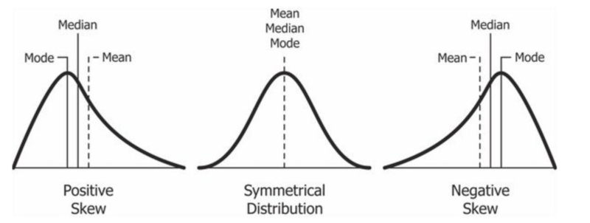
Positive Skew and Central Tendency
In most cases in project management, we have a positive skew. Things might finish a little bit quicker or cheaper – but there’s a very good chance it could take a lot longer and require a lot more money.
Retrieved from https://en.wikipedia.org/wiki/Skewness
In statistics, the most common measures of Central Tendency are the mean (average), the median (half of the data is on either side), and the mode (the most frequent value or the peak of the data).

Slide 49
3-Point Estimate (TE) Formulas
Typically Activity duration (and cost) estimates are skewed curves, and frequently we don’t have historical data so we estimate using 3 points, Optimistic, Most Likely, Pessimistic.
We use two types of 3-point estimating formulas to derive our estimate called TE.
Triangular estimate, a simple average (a+m+b)/3
PERT Method of duration estimate which is a weighted average, and produces a more accurate estimate (closer to the median) for skewed distributions.
What if O, M, and P were 2, 3 and 10? Triangular vs PERT? What would be the differences in the estimates.?
Notes:
Using P for pessimistic (b), and O for optimistic (a) and ML for most likely (m) also called ML.
Triangular Distribution: (P + O + ML) / 3.
(2+3+10)/3= 15/3 = 5
PERT Distribution (P + O + 4ML ) / 6 Note in this formula ML is weighted 4 times as much as O or P in the formula.
(2+4*3 + 10)/6 = 24/6 = 4

Slide 50
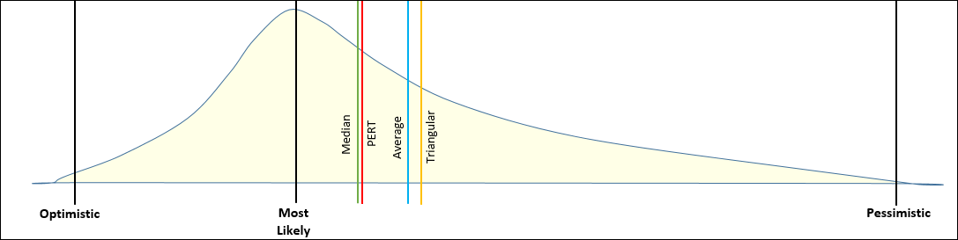
Comparison of Skewed Distribution Measurements
Median & Average – we need a data set
PERT & Triangular – we can use O,M,P
One reason a PERT estimate is used for a duration is that it typically is close to the Median (50% of the probability is less than the median and 50% more).
If we only have O, M and P estimates we cannot calculate the Median, but we can calculate a PERT estimate. And we can’t calculate the real Average with just O, M, P, only a 3-point triangular average. But what does an “average” really tell us in a skewed distribution?
Notes:
We need a set of data to calculate the Average (Mean) and the Median. And if we’ve done the same activity 20 times before, then that would be enough data to do so.
But if we don’t have the data, we’d probably be using an O, M and P for our estimate. With O, M, P we can calculate a triangular average, which is close to a data set average – and a PERT which is close to the Median.

Slide 51
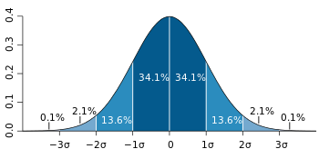
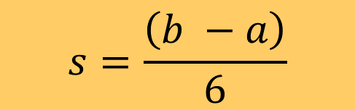
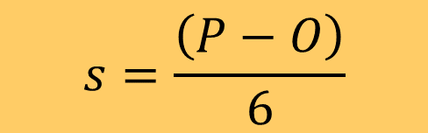
Standard Deviation When Using O, M, P
Frequently we don’t have data on Cost or Duration, and so we use 3 estimation points, O, M, P
Most likely (m) or M
Most pessimistic (b) sometimes “P”
Most optimistic (a) sometimes “O”
Simplified formula for Standard Deviation S
$$s=\frac{\left(b −a\right)}{6}$$
$$s=\frac{\left(P−O\right)}{6}$$
Source: https://en.wikipedia.org/wiki/Standard_deviation
O
P
6 standard deviations
Notes:
Whenever we are performing tasks we’ve never done before or we’re doing them using a different approach – we wouldn’t have historical information.
But we can find the best experts and come up with a Mostly Likely estimate (M), an Optimistic estimate (O), and a Pessimistic estimate (P).

Slide 52
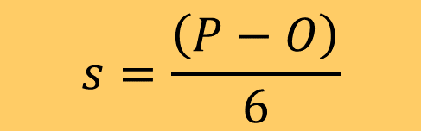
Variances When Using O, M, P
Variance is simply the square of a Standard Deviation (S)
Simplified formula for Variance, take the simplified standard deviation and square it
Variance = S²
We’ll need to use Variances when we determine the standard deviation of a path in a network diagram
$$s=\frac{\left(P−O\right)}{6}$$
Notes:
Whenever we are performing tasks we’ve never done before or we’re doing them using a different approach – we wouldn’t have historical information.
But we can find the best experts and come up with a Mostly Likely estimate (M), an Optimistic estimate (O), and a Pessimistic estimate (P).

Slide 53
Summary of Module
Term: In the PMBOK, what is Progressive Elaboration?
Can we estimate the duration of a WP if we haven’t identified the Activities?
Understand how to create a Schedule Management Plan
Understand and apply key scheduling terminology.
Apply the logic used to create activity networks, including predecessor and successor tasks.
Develop an activity network using Activity-on-Node (AON or AOA) techniques.
Perform activity duration estimation based on the use of probabilistic estimating techniques.

Slide 54
Homework
Refer to the Start Here section of this module
Read for the next module
Kerzner (this reading for the next module is the same as it was for this module) 12th Ed p 409-431, 11th p. 597-620
PMBOK 6th Ed 6.5, 6.6, 5th 6.6, 6.7
Review PPT files with solutions
Assignments, practice quizzes and graded quizzes, check the Course at a Glance and FOL/Content/Course Assignments & FOL/Evaluations/Quizzes

Slide 55


